Slide 1
2018 Grants Summit
September 19, 2018
Notes:
Tou Ya

Slide 2
Agenda Overview
9:00 AM Welcome, Dr. Colleen McCabe
9:15 AM
A View from the System Office
Using WTCS Data to Inform Statements of Need, Dr. Hilary Barker
Grant spending overview, Troy Brown
9:50 am
Grant Guidelines Overview, Julie Tyznik and Tou Ya Khang
Application Forms, Rubrics and Triannual Reports
State and AEFLA updates
10:20 AM Break
10:30 AM Perkins V updates, Dr. Colleen McCabe, Dr. Hilary Barker and Julie Tyznik
11:15 AM Q & A Forum
11:15-11:40 Perkins Panel; Julie Tyznik, Ann Westrich, Karen Showers, Colleen Larsen
11:40-12:00 State Grants Panel; Brandon Trujillo, Katie Roberts, Mark Johnson
12:15 Moving Forward, Tou Ya Khang
12:30 PM Adjourn
Notes:
Tou Ya

Slide 3
Dr. Colleen McCabe
Welcome!
WTCS Vice President and Provost
Notes:
Colleen M.

Slide 4
Grant Spending Overview
2018 Grants Summit
Troy Brown
WTCS Grants Accountant
Notes:
Troy

Slide 5
Grant Guidelines Overview
2018 Grants Summit
Julie Tyznik and Tou Ya Khang
Notes:
Tou Ya

Slide 6
Application Forms
Still four application forms (State, Perkins, WAT and Emergency Assistance)
Project title moved up from line six to line two
Grant contact name & contact information on one line
Project Manager(s) name & contactt information on one line
WTCS use only section moved to cover page
Includes four domains to align with SSC initiative (except WAT)
Table for compliance monitoring & evaluation (except WAT and Emergency Assistance
Notes:
Tou Ya
Show

Slide 7
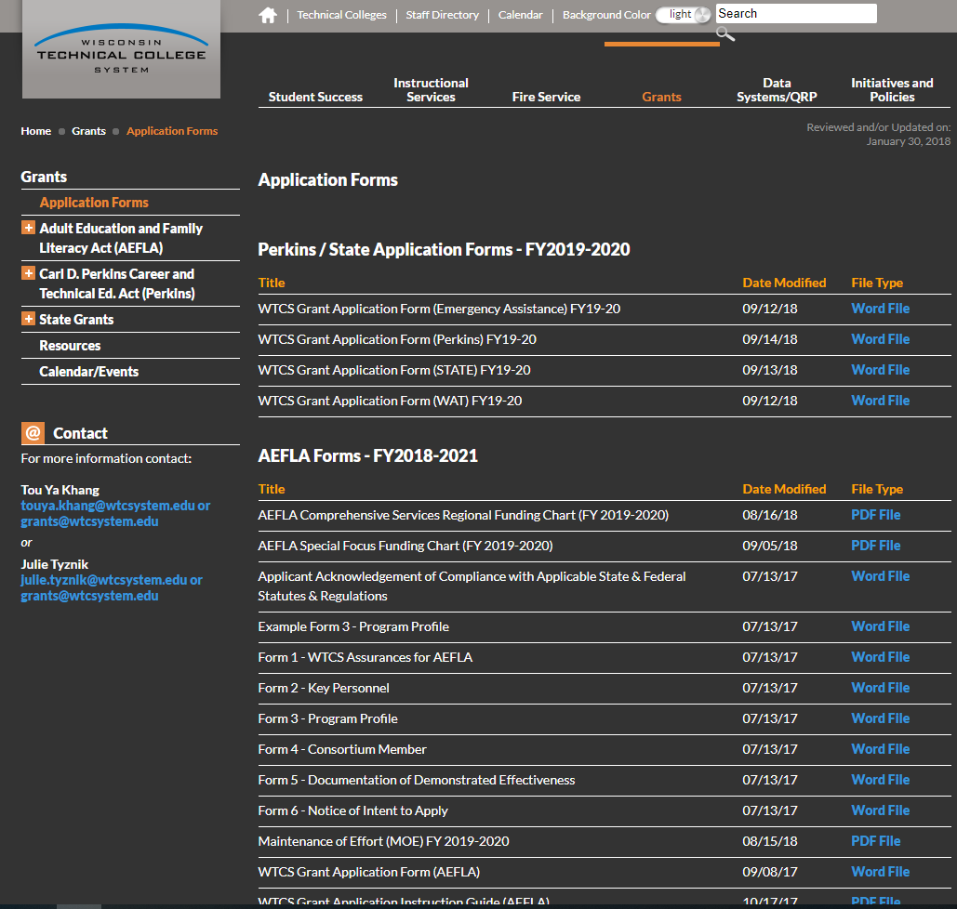
Application Forms
Notes:
Tou Ya

Slide 8
Rubrics
Compliance requirement – applications that are missing required components will not be considered for funding
New scale for Competitive State Grant categories (Core Industry, Developing Markets, Completion and Career Pathways)
0 – Criteria not addressed
1 – Criteria addressed, but lacking key components
2 – Criteria addressed, but not clearly connected
3 – Criteria addressed, but one or two questions remain
4 – Criteria clearly defined and no questions remain
Points and percentage scoring
WAT rubric remains the same as FY2018-2019
No Perkins Rubrics
Notes:
Julie

Slide 9
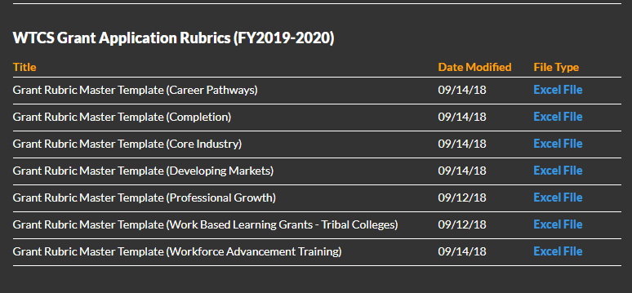
Rubrics
https://mywtcs.wtcsystem.edu/grants/grant-application-forms
Notes:
Julie

Slide 10
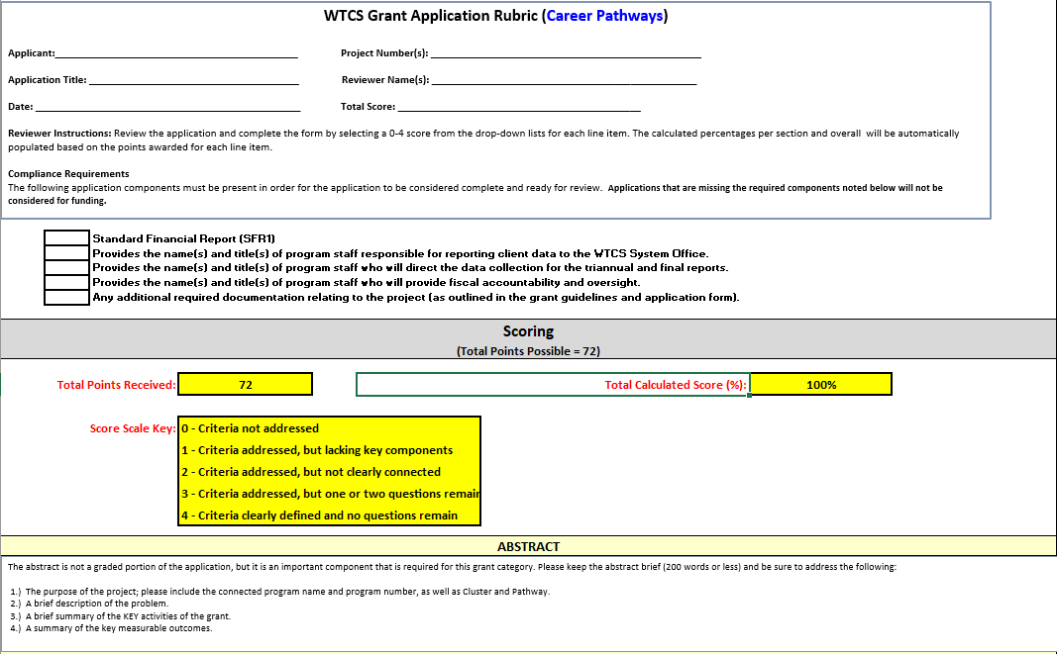
Rubrics
Notes:
Julie

Slide 11
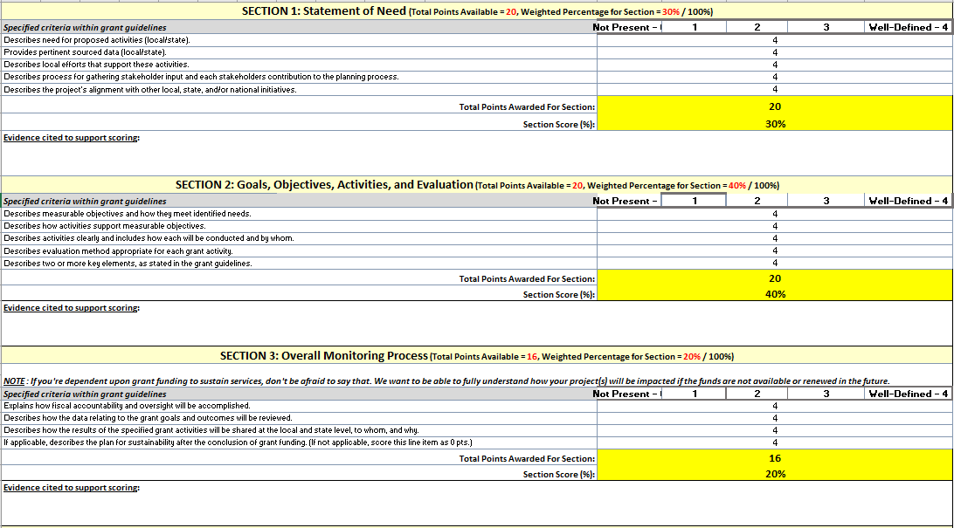
Rubrics
Notes:
Julie

Slide 12
Triannual Reporting
New template (all three reports on one form)
Start using new template with FY2018-2019 Grants (first report due November 15, 2018)
WTCS will continue to provide feedback regarding the report with colleges
Notes:
Julie

Slide 13
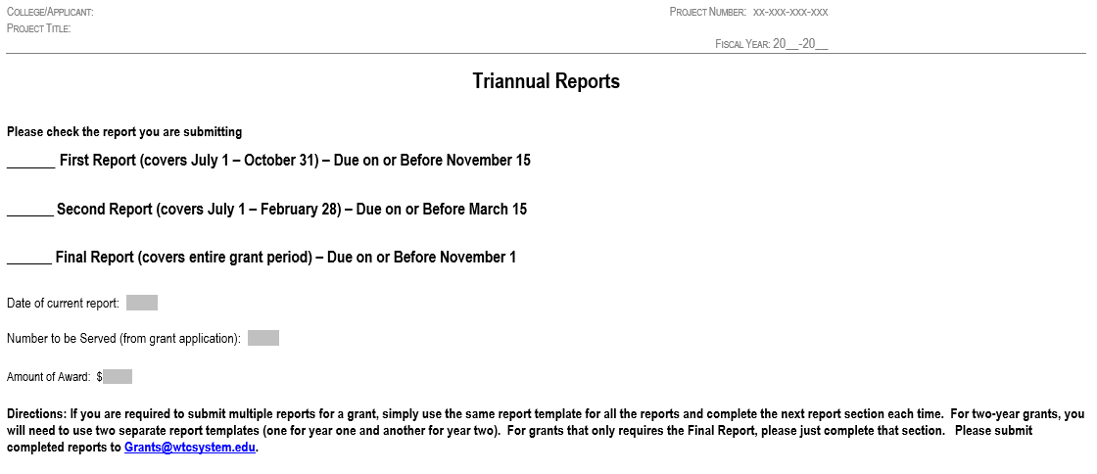
Triannual Reporting
Notes:
Julie

Slide 14
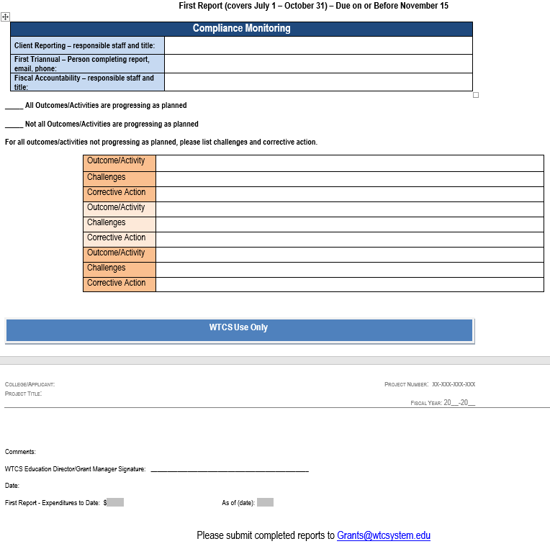
Triannual Reporting
Notes:
Julie

Slide 15
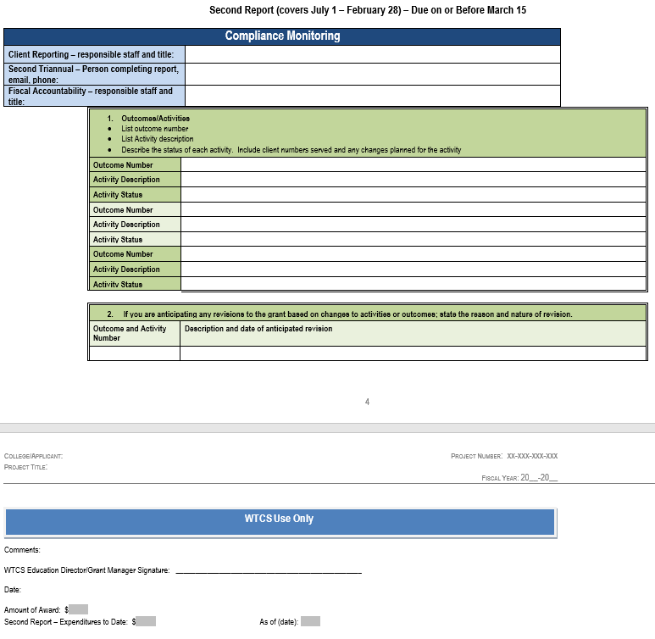
Triannual Reporting
Notes:
Julie

Slide 16
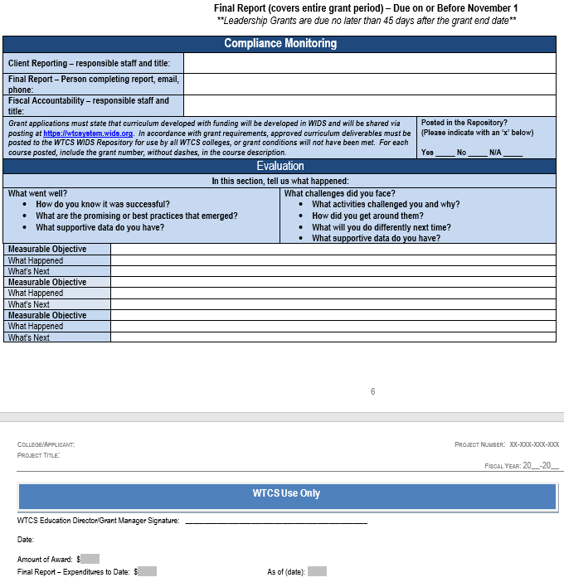
Triannual Reporting
Notes:
Julie

Slide 17
State Grants Updates
All applications with the exception of the Emergency Assistance, Apprentice-Related Instruction and WAT Grants are due January 17, 2019
Emergency Assistance application due on April 15, 2019
WAT applications due May 1, 2019
Apprentice-Related Instruction Grant – funds will be made on an invitation only basis (Systemwide Apprenticeship Curricula and Direct Instruction Support)
Submit all applications to Grants@wtcsystem.edu
Notes:
Tou Ya

Slide 18
AEFLA Grants Updates
AEFLA FY2019-2020 continuation application due on January 24, 2019
Applicants need to update and submit their grant application that was approved in 2018-19
Use WTCS Grant Continuation Instruction Guide (AEFLA) FY2019-2020 to complete application
Updated Comprehensive Services Regional Funding Chart for FY2019-2020
Special Focus Funding amount for FY2019-2020 should be the same as approved amount for FY2018-2019
Updated Maintenance of Effort for FY2019-2020 (went down)
Notes:
Tou Ya

Slide 19
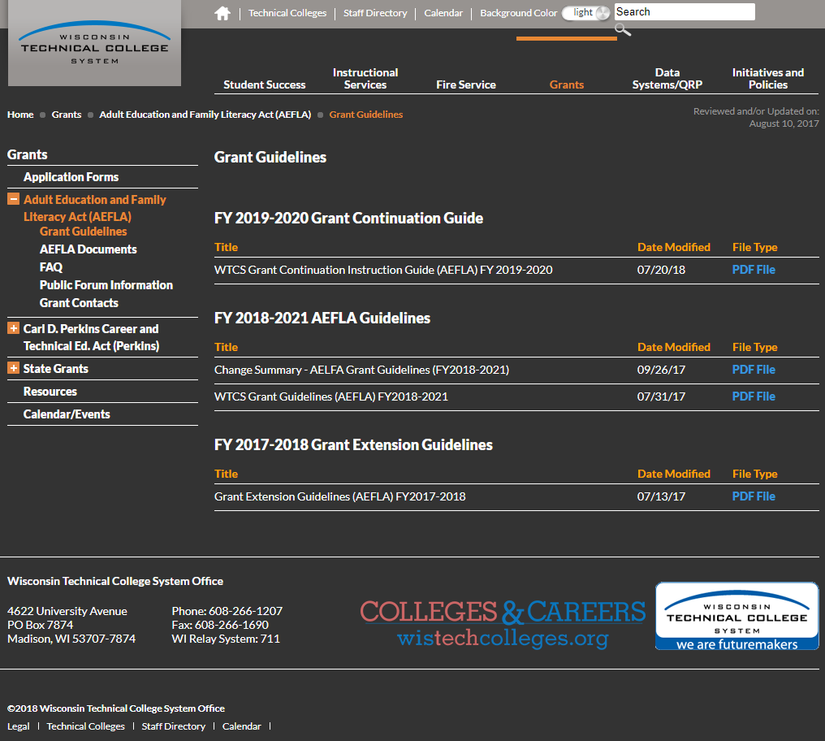
AEFLA Grant Continuation Guide
Notes:
Tou Ya

Slide 20
AEFLA Funding Charts & MOE
Notes:
Tou Ya

Slide 21
AEFLA Grants Updates
Contents of the AEFLA Grant Guidelines for FY2018-2021 still applicable
Submit all applications to Grants@wtcsystem.edu
Notes:
Tou Ya

Slide 22
Perkins Panel
Q & A Forum
Julie Tyznik, Ann Westrich, Karen Showers and Colleen Larsen
Notes:
Perkins panel (Tou Ya will have them come up and take questions)

Slide 23
State Panel
Q & A Forum
Katie Roberts, Scott DuBenske, Tim Weir, Mandy Johnson and Karen Showers
Notes:
State panel (Tou Ya will have them come up and take questions)

Slide 24
Questions?
Post to Q & A Document
Contact WTCS Grants Team
Email: Grants@wtcsystem.edu
Notes:
Tou Ya

Slide 25
Moving Forward
Perkins applications due December 14, 2018
State applications due January 17, 2019
AEFLA applications due January 24, 2019
Notification of grant awards in March 2019
Grant activities begin July 1, 2019
Notes:
Tou Ya

Slide 26
Thank You!
Information regarding the WTCS grant guidelines can be found here.
http://mywtcs.wtcsystem.edu/grants
Notes:
Tou Ya

