Slide 1
Spring 2021: WTCS Ability to Benefit State Option Meeting
March 9, 2021

Slide 2
Agenda
Spring/Fall Meetings & Resources
Forming a local implementation/steering team
Explore the ATB Guide planning tools
Share out: Planning/Implementation of student supports
Identifying ATB students
Enrollment/Admissions
Career pathway selection
Financial aid processing
Student support service planning
Preparing for data collection/reporting

Slide 3
Resources
WTCS Adult Education Page WTCS Ability to Benefit State Process
ATB Student Testimonies
Promo length

Slide 4
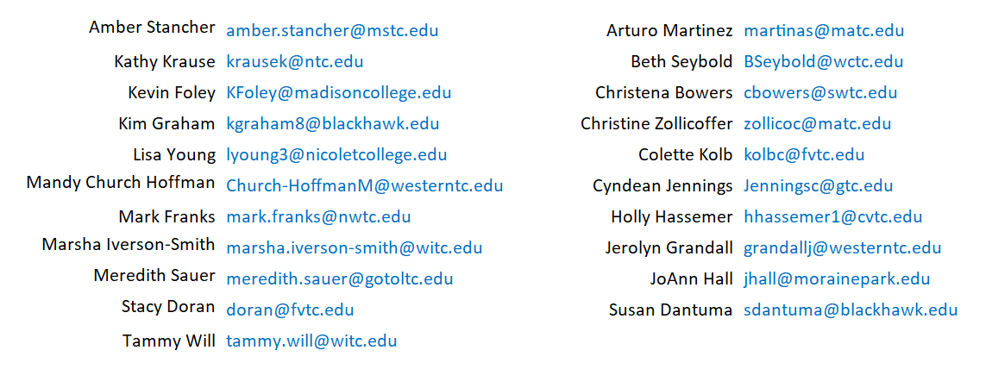
ATB Liaisons atbliaison@wtcsystem.edu

Slide 5
ATB State Option - A Community of Practice
In the context of the ATB state option, community of practice goals include:
Sharing techniques and strategies with one another
Supporting one another
Fostering System collaboration
Improving outcomes for ATB students
You driving future meeting topics

Slide 6
A Path Forward Forming an Implementation/Steering Team
Pam Gerstner – NWTC
Associate Dean, General Studies
Meredith Sauer – LTC
Dean, General Studies
Dr. Arturo Martinez - MATC
Associate Dean, Adult Education

Slide 7
College Share Out
Identifying ATB students
Enrollment/Admissions
Career pathway selection
Financial aid processing
Student support service planning: Orientation, Advising, Academic Support/Tutoring, Faculty feedback
Preparing for data collection/reporting

