Slide 1
WTCS Dual Credit Dashboard Training

Slide 2
Quick Note On Dashboard Data Access
College Data Access Coordinators request access via the WTCS Portal
Colleges decide who has access
Issues with login credentials, contact WTCS Office IT at support@wtcsystem.edu
Questions about the dashboard data, contact Ben Konruff ben.konruff@wtcsystem.edu or Ann Westrich ann.westrich@wtcsystem.edu

Slide 3
Training Goals
Build your understanding of the dashboard data definitions
Build your understanding of how to navigate the dashboard
Discuss ways you might use the dashboard data to strengthen dual credit programming

Slide 4
Dashboard Data Uses
Discuss how you envision your college using the dashboard data
Keep in mind, the dashboard data will not give you the answer to everything. It should be used as a tool to facilitate deeper conversation among staff. It may also lead to exploring additional data collected at your college.

Slide 5
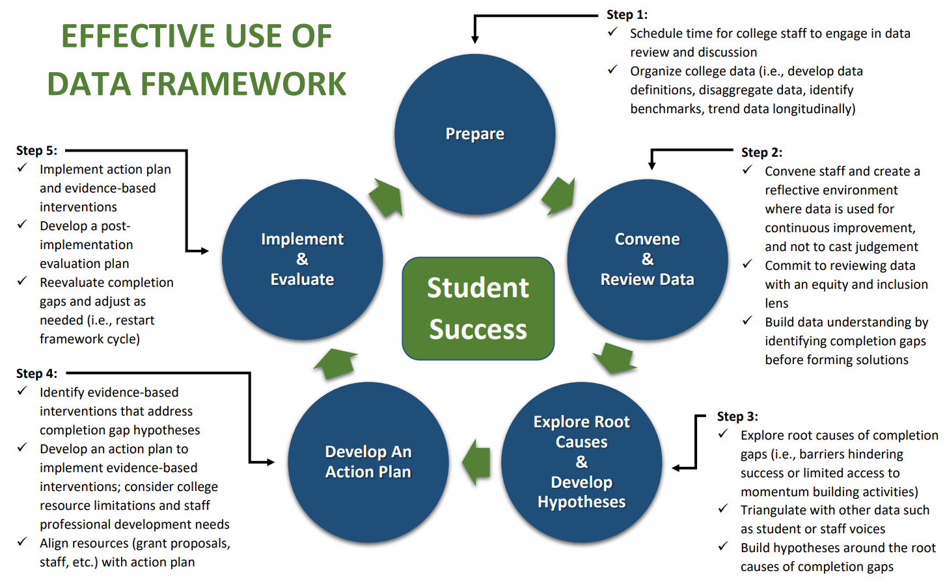
A Framework for Dashboard Data Use

Slide 6
Training Structure
Explore each page on the dashboard
Review data business rules
Navigate the dashboard page together
Individual dashboard page exploration with scenarios
Discussion on possible data uses

Slide 7
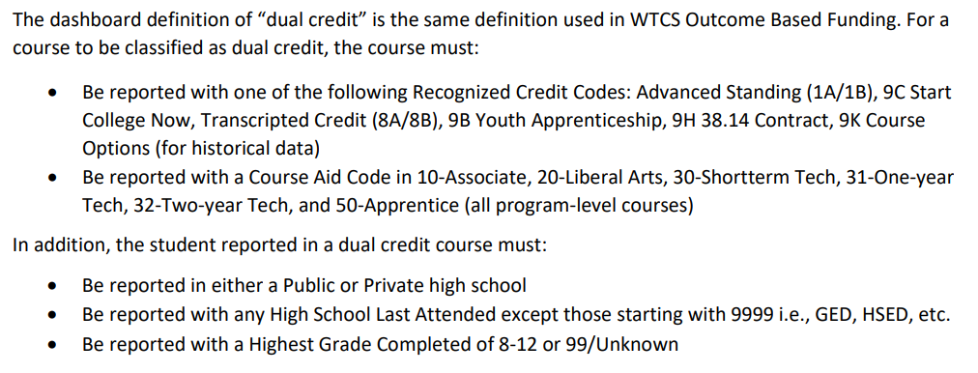
Dual Credit Definition

Slide 8
Dual Credit Dashboard Pages
Dual Credit Prevalence
How many students/course enrollments/credits are reported in dual credit?
Dual Credit Credentials
How many dual credit students receive a WTCS approved credential prior to high school graduation, and how many WTCS approved credentials are awarded to high school dual credit students prior to high school graduation?
Dual Credit Transitions
What percent of students who participated in a dual credit course transition to postsecondary education (i.e., WTCS education or to an institution outside of the WTCS) within 1 year, 2 years, or 3 years of high school graduation?
Dual Credit Outcomes
What are the outcomes (first year cumulative GPA, 2nd year program retention, and 3rd year program graduation) among students with dual credit who transition into a WTCS approved program the year after high school graduation? How do these compare with direct from high school enrollees in a WTCS program who did not take dual credit?

Slide 9
Log Into the Dual Credit Dashboard
Navigate to your internet browser of choice.
Enter in the URL for Tableau: https://tableau.wtcsystem.edu
After you have entered the URL for Tableau, a popup will appear prompting for your credentials. Navigate to the popup to enter your credentials.
For “User name” enter your WTCS account username.
For “Password” enter your WTCS account password.
Click “OK”.
You should now be at the “Projects” page.
Click the “WTCS” folder.
Select the Dual Credit Dashboard folder and open the dashboard

Slide 10
Dual Credit Prevalence: Data Definitions
The WTCS Dual Credit Prevalence page presents a filter that allows users to select the indicator they want to populate on the page. Use the Chart Type filter to populate student headcount, course enrollments, or course credits data associated with dual credit participation.
Indicator | Definition/Calculation | Notes
Student Headcount | The unduplicated count of students enrolled in WTCS dual credit courses | Data Source: Client Reporting System
Course Enrollments | The count of course enrollments in WTCS dual credit courses | Data Source: Client Reporting System
Course Credits | The count of course credits associated with WTCS dual credit course enrollments | Data Source: Client Reporting System

Slide 11
Dual Credit Prevalence: Data Explore
Explore the dashboard page with your group!

Slide 12
Dual Credit Prevalence: Scenario
Individually explore the data using the below scenario as a guide, come back together as a group, and discuss.
Scenario: Two other colleges have reached out to you. They both have high schools that are considering offering dual credit courses in Culinary. Before they commit, they are wondering if you have any data that shows how many students are taking culinary courses and are successfully completing them in your district. Use the dashboard to explore this scenario further.
Also, think about some additional ways you might use the dashboard data or who you might share it with.

Slide 13
Dual Credit Credentials: Data Definitions
The WTCS Dual Credit Credentials page presents a filter that allows users to select the indicator they want to populate on the page. Use the Chart Type filter to populate graduate count or credentials awarded.
Indicator | Definition/Calculation | Notes
Graduate Count | The unduplicated count of high school students who enrolled in WTCS dual credit and earned a WTCS approved credential prior to high school graduation | Year of High School Graduation is used to determine when a student graduates from high school. If a dual credit student is reported with a Year of High School Graduation of 2022, then the WTCS approved credential must be awarded in fiscal year 2022 or earlier. WTCS approved credentials include all credentials accepted in Client Reporting. Data Source: Client Reporting System
Credentials Awarded | The count of WTCS approved credentials awarded to WTCS dual credit students prior to high school graduation | Year of High School Graduation is used to determine when a student graduates from high school. If a dual credit student is reported with a Year of High School Graduation of 2022, then the WTCS approved credential must be awarded in fiscal year 2022 or earlier. WTCS approved credentials include all credentials accepted in Client Reporting. Data Source: Client Reporting System

Slide 14
Dual Credit Credentials: Data Explore
Explore the dashboard page with your group!

Slide 15
Dual Credit Credentials: Scenario
Individually explore the data using the below scenario as a guide, come back together as a group, and discuss.
Scenario: A group of automotive employers in your district have come together with a desperate need for skilled labor in the automotive field. You think a dual credit Automotive Academy might be a solution. You want to use data to guide which colleges you connect with for future discussion on their successes and challenges. Use the dashboard to explore this scenario further.
Also, think about some additional ways you might use the dashboard data or who you might share it with.

Slide 16
Dual Credit Transitions: Data Definitions
Indicator | Definition/Calculation | Notes
High School Graduate Count with Dual Credit | The unduplicated count of high school graduates who enrolled in WTCS dual credit prior to high school graduation | Year of High School Graduation is used to determine when a student graduates from high school. If a student is reported with a Year of High School Graduation of 2022, then WTCS dual credit must be reported in fiscal year 2022 or earlier. Data Source: Client Reporting System
% Enroll in X Years | Denominator: The high school graduate count with dual credit for a high school graduation year Numerator: Of those in the denominator, the number who enroll in college in the WTCS or outside the WTCS within 1 year of high school graduation, within 2 years of high school graduation, or within 3 years of high school graduation | Enrollment in college is assessed on a fiscal year basis. For example, if a WTCS dual credit student is reported with a Year of High School Graduation of 2022, then 1-year transitions will assess college enrollment for fiscal year 2023 and 2-year transitions will assess college enrollment for fiscal year 2023 or 2024. College enrollment includes enrollment in the WTCS or enrollment verified through a data match in the National Student Clearinghouse System with an enrollment begin date within the assessed fiscal year. Data Source: Client Reporting System and National Student Clearinghouse System

Slide 17
Dual Credit Transitions: Data Explore
Explore the dashboard page with your group!

Slide 18
Dual Credit Transitions: Scenario
Individually explore the data using the below scenario as a guide, come back together as a group, and discuss.
Scenario: Your college has identified high school to college transitions as a top priority in the college strategic plan. Your college wants to hire high school career coaches to target a few high schools in your district to support dual credit transitions. Your college plans to write a grant to fund the positions. What dashboard data might you use to support your application? How would you prioritize which high schools to target?
Also, think about some additional ways you might use the dashboard data or who you might share it with.

Slide 19
Dual Credit Outcomes: Data Definitions
The Dual Credit Outcomes dashboard page presents a series of student success outcomes for students who enrolled in dual credit and enrolled in a WTCS credential the year after high school graduation. Outcomes for direct enrollees in a WTCS credential after high school graduation who did not take dual credit are also presented for comparisons.
Indicator | Definition/Calculation | Notes
1st Year GPA in a WTCS Program | Cumulative GPA across courses that include course aid codes 10-Associate, 20- Liberal Arts, 30-Shortterm Tech, 31-One-year Tech, 32-Two-year Tech, and 50-Apprentice that have a course grade of A, A-, AB, B+, B, B-, BC, C+, C, C-, CD, D+, D, D-, DF, or F | Includes students who direct enroll into a WTCS approved credential within one year of high school graduation. Year of High School Graduation is used to determine when a student graduates from high school. Data Source: Client Reporting System

Slide 20
Dual Credit Outcomes: Data Definitions
Indicator | Definition/Calculation | Notes
2nd Year Retention in a WTCS Program | Denominator: Number of program students who were enrolled in an FTE generating course during fiscal year 20XX Numerator: Of those in the denominator, the number of program students who completed the same program in any of the fiscal years assessed (20XX and 20XX+1) or were reported in the same program and enrolled in an FTE generating course during fiscal year 20XX+1 | Includes students who direct enroll into a WTCS approved credential within one year of high school graduation. Year of High School Graduation is used to determine when a student graduates from high school. Data Source: Client Reporting System
3rd Year Completion in a WTCS Program | Denominator: Number of program students who were enrolled in an FTE generating course during fiscal year 20XX Numerator: Of those in the denominator, the number of program students who graduated from the same program in any of the fiscal years assessed (20XX, 20XX+1, and 20XX+2) | Includes students who direct enroll into a WTCS approved credential within one year of high school graduation. Year of High School Graduation is used to determine when a student graduates from high school. Data Source: Client Reporting System

Slide 21
Dual Credit Outcomes: Data Explore
Explore the dashboard page with your group!

Slide 22
Dual Credit Outcomes: Scenario
Individually explore the data using the below scenario as a guide, come back together as a group, and discuss.
Scenario: You are attending a Welding faculty meeting at your college to discuss dual credit. There is skepticism among faculty that dual credit is not impactful to student success. This perception is stalling expansion of offerings coordinated by your college. How might you use state-wide data on the dashboard to “demystify” this faculty perception?
Also, think about some additional ways you might use the dashboard data or who you might share it with.

Slide 23
Next Steps
Consider reviewing the Dashboard Rollout Plan document with staff at your college
Explore the Dashboard Guide
Discuss how you will check-in with staff to address any questions

