Slide 1
Differentiation
Makes a Difference:
Supporting Students at All Stages
JennaRose Dahl
Customer Manager
Olia Tomski
Customer Representative
Erin Helland
ESL Instructor and Chair, MATC
Notes:
JennaRose introduces presentation and us

Slide 2
Agenda
Open Discussion
Deep Dive into Multilevel Classes
Advantages and Challenges of a Multilevel Classroom
Let's Talk Solutions!
Classroom Models
Breakout Activity
Now You!
Notes:
Xue

Slide 3
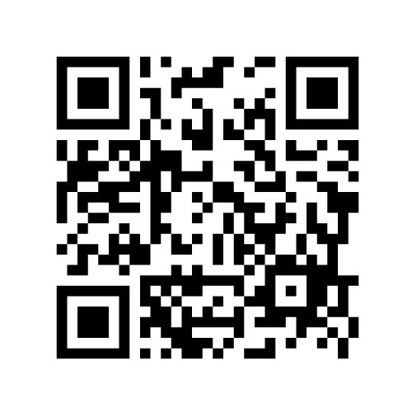
Check in with us!
Notes:
JR(link in the chat)

Slide 4
Discuss
How do you organize your multilevel classroom?
Discuss in the chat!
Notes:
Xue
1. Ask: "How do you organize your multilevel classes?"
2. Ask "Do any of you divide your classes into two levels and teach a lower level ICL to the lower level students while higher level students work independently, and then switch?"
3. Ask "While you teach the ICL to one group, what do you have your other group of students work on?" (SL, VP, Expansion Activities)
4. OPTIONAL Ask "If you teach the ICLs to two different groups, do you ever do whole group activities? If so, what do you use?" (Readers, Prepare for CASAS, Expansion Worksheets)
How do you organize your multi-level classroom?

Slide 5
“Teaching multilevel classes does not mean preparing multiple lesson plans each day, rather, it’s a question of providing multiple options within the same lesson plan.”
Parrish, Teaching Adult ESL: A Practical Introduction
Notes:
Xue
1. Ask: "How do you organize your multilevel classes?"
2. Ask "Do any of you divide your classes into two levels and teach a lower level ICL to the lower level students while higher level students work independently, and then switch?"
3. Ask "While you teach the ICL to one group, what do you have your other group of students work on?" (SL, VP, Expansion Activities)
4. OPTIONAL Ask "If you teach the ICLs to two different groups, do you ever do whole group activities? If so, what do you use?" (Readers, Prepare for CASAS, Expansion Worksheets)

Slide 6
Discuss
Let’s think… What are some of the ways your students can be multilevel?
English language skills: listening, speaking, reading, and writing
First-language literacy
Digital Literacy
Job skills
Education - formal/informal
Personality
Learning style
Comfort with new culture
Socioeconomic condition
And more!!
Share out!
Notes:
JennaRose: All levels 2’s are not the same--

Slide 7
Multilevel Classrooms
Advantages:
Empower students through peer-to-peer learning opportunities
Allow the modeling of critical thinking and problem-solving skills
Create an environment to serve learners of varying levels in one location
Foster teamwork and leadership skills
Challenges:
Foster a strong community
Student's complete exercises/activities at different times
Varying student goals
Ensure all students are challenged and interested
Notes:
Xue

Slide 8
Get Student Input
Ask your students!
Have your students share why they want to learn English.
To improve my speaking skills
To get a job
To get into college
To use for traveling
To learn the rules of grammar
Other ____________
Student input can help you identify the varying needs of individuals in your class.
Notes:
Xue
Provide this as an idea for an activity to help teachers determine students needs/wants in the classroom. (a form of multilevel)

Slide 9
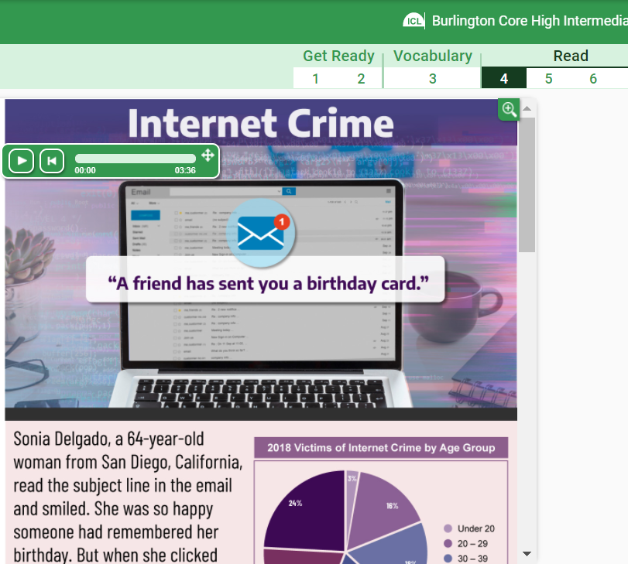
Student Pairs
When pairing students, consider their different skills and strengths.
Notes:
JR
You might have a student who is great with technology, but has low English reading skills. You might have another student who is a confident reader, but not familiar with the internet. In a lesson about internet crime, they could be a great pair– one with stronger understanding of the digital world, and one with a stronger reading ability.

Slide 10
Small Groups & Partner Work
Same Level:
Allow students of the same level to work together
Assign different, level-appropriate tasks to each group
Mixed Level:
Allow higher-level students to help and challenge lower-level students
Especially useful when students can explain in their first language
Notes:
JR

Slide 11
Multilevel Questions
Challenge: Various reading comprehension levels
WHO?
WHAT?
WHEN?
Who is responsible?
Who can help solve the problem?
Who is most directly impacted by ___________?
What is the main idea?
What details support the main idea?
How are the main idea and the passage related?
When did the event take place?
When did the solution to the problem occur?
When should we look for a different solution?
Try
WHERE?
WHY?
HOW?
Where did ________ happen?
Where have you seen a similar situation?
Where will we get more information about _________?
Why did ____ happen?
Why should people know about _______?
Why is ________ important? Explain your reason.
How did he get a job?
How is _________ an example of ________?
How does __________ benefit us or others?
Use a variety of
questions to evoke different levels of thinking.
Notes:
Xue
Asking multilevel questions is important to keep all levels engaged. When teachers adjust the learner outcomes for various levels, students don't become bored from lack of challenge or become disengaged from a lesson that feels too difficult or frustrating. Here are some examples of leveled questions using WHO, WHAT, WHEN, WHERE, WHY, and HOW. (Choose one to walk through)

Slide 12
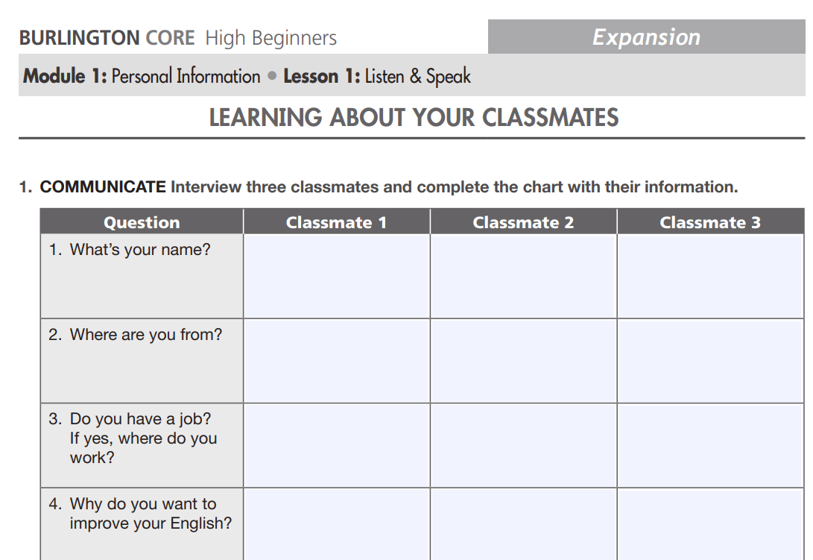
Warm-ups, games, mingles
Challenge: Foster a strong classroom community
Try
Whole class warm-up activities and group games at the end of class.
Mix pairs and small groups so students get to know each other.
Use mingle activities to get students talking.
Notes:
JR

Slide 13
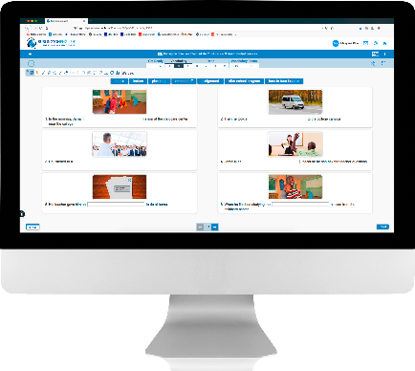
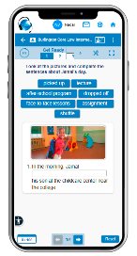
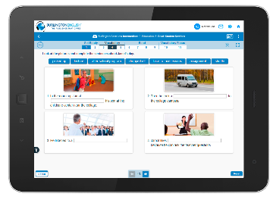
Self-Directed Learning
Challenge: Students finish class activities at different times
Try
Assign independent activities to students who complete work before others.
Use open-ended tasks without time limits.
Students can access the BurlingtonEnglish app and work on their corresponding Student Lesson or Vocabulary Practice section.
Notes:
JR

Slide 14
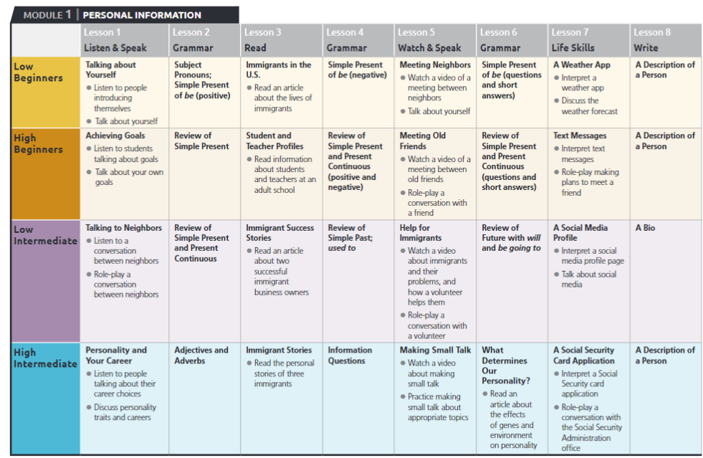
Theme-based Content
Challenge: Choose a curriculum for a multilevel class
Try
Choose a curriculum that is theme-based, which keeps all students on the same topic even if they are at different levels.
Notes:
JR

Slide 15
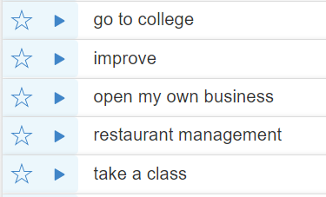
Learner Goals
Challenge: Students have different goals
Try
Meet with each student to learn about their individual goals.
Keep track of each student's level and goals and check in with them regularly about their progress toward those goals.
Keep your list of student goals handy for when you break students up into pairs or small groups. This also helps students stay accountable for their own learning.
Notes:
JR
Consider creating a list of goals for them to choose from.
Also helps students stay accountable for their own learning!

Slide 16
Large Class Size
Challenge: The struggle of helping everyone at once!
Try
Have students correct each other!
You can give some students the answer key and have them provide support to the others.
Give students two different sets of the practice materials – one with half of the answers completed, and the other with the other half.
Notes:
JR -
You could either give some students the answer key, and have them provide support to the others, or give students two different sets of the practice materials– one with half of the answers completed, and the other with the other half.

Slide 17
Create equal opportunity!
Challenge: Higher-level students answer questions first
Try
In-Person Ideas:
Write students’ names on popsicle sticks. Put them in a coffee mug. When it’s time to ask a question, pull one out at random.
Set a short timer for think time. When the timer goes off, students can respond all at once.
Virtual Idea:
Waterfall method. Before asking your question, tell students to type their answer in the chat, but wait until you give the go-ahead to click “send.”
Notes:
JR

Slide 18
Online Instruction
Teacher-led Instruction
Station Rotation Model
Floating Teacher
Collaborative Activities and Stations
Notes:
Xue
Does anyone use Rotation Model? (Teacher Station/Independent Station/Partner & Group Station)
If yes, ask:
•How does each physical space look?
•Do you have different expectations for your student depending on their level?
•What are some best practices? (e.g., Having a printed instructions of how each station will look like)
"This particular tack to blended instruction is typically credited with establishing a controlled routine in the classroom while allowing students some degree of control over the pace and path of their learning. In other words, Station Rotation allows teachers to personalize instruction at a much higher degree than the traditional classroom." - https://www.blendedlearning.org/3-secrets-to-successful-station-rotations/

Slide 19
Direct Instruction:
Core English Language
Lab Rotations
Direct Instruction:
Career/IET
Computer Lab
Notes:
Does anyone use Rotation Model? (Teacher Station/Independent Station/Partner & Group Station)
If yes, ask:
•How does each physical space look?
•Do you have different expectations for your student depending on their level?
•What are some best practices? (e.g., Having a printed instructions of how each station will look like)

Slide 20
Discuss
Volunteers, Classroom Aides
& Teaching Assistants
Turn and discuss.
Do you have support staff that help in class?
How do you use support staff in your classroom?
Notes:
Xue
Virtual Setting:
Flip class method: teacher teaches one section of class/volunteer helps other section with Student Lessons (Breakout rooms)
Breakout rooms – Volunteers goes through a chapter with students
1:1 technology aid
"Behind the Scenes" Help:
Signing into teacher’s accounts – checking for accuracy in Progress – less than “X” percent, notifying teacher
Seeing what volunteer’s strengths are and determining how they can best support students
In-Person:
- Conversations with tutors or breakout rooms practicing speech

Slide 21
Table Talk
We are going to take 10 minutes to look at a BurlingtonCore In-Class Lesson.
Discuss how you would differentiate this reading activity for:
beginning
intermediate
and advanced-level students
Notes:
JR
High Beginners: Module 5 (Health), Lesson 3 (Read: Preventing Back Injuries), Activity 4.
1. Go over the instructions on the slide. *If using breakout rooms in Zoom, copy and paste the instructions into the chat. 2. Let groups know how much time they have.
**Other ideas you can share if needed**
1. Give students of different levels, different jobs in each in-class activity:
B and LB: “Anytime I underline a word in red, write it in your notebook”
HB: “Anytime I circle a word or phrase, write it in your notebook”
LI/HI: “Anytime I draw a rectangle around a word or phrase, write it in your notebook”
2. Lower-level students focus on one part of speech (ex. ‘find nouns all the nouns’)
Mid-level students do this activity as written
Adv - Summarizing ICL Watch videos and audio clips (Watch and Speak & Listen and Speak lessons)
When everybody comes back, share the Activity 4 on the screen as you discuss.
Another breakout room or group share: "What are some ideas from today that you'd like to use in your multilevel classroom?"
You will all be placed into a Breakout room with a BurlingtonEnglish representative.
Select one Scribe to take notes and one Presenter to share.
In your groups, you will have 10 minutes to look at a BurlingtonEnglish In-Class Lesson activity
Discuss how you would differentiate this reading activity for your beginning, intermediate, and advanced-level students.
Select Burlington Core High Beginners
Module 5 (Health), Lesson 3 (Read: Preventing Back Injuries), Activity 4.

Slide 22
Now You!
One person from each group:
Share your differentiation tips!
Notes:
Xue

Slide 23
Questions?
Notes:
Feel free to mute or type your question in the chat if you have any questions!

Slide 24
In case you missed it
Notes:
Feel free to mute or type your question in the chat if you have any questions!

Slide 25
JennaRose Dahl
JennaRose.D@BurlingtonEnglish.com
612-368-3402
Olia Tomski
Olia.T@BurlingtonEnglish.com
715-619-6720
The BurlingtonEnglish TEAM
Is Here to Assist You EVERY STEP of the Way!
Notes:
Kori

