Slide 1
Overview of Adult Education Content Standards

Slide 2
Timeline of AEFLA Sessions
April 15 - Overview of AEFLA, Eligibility, & WTCS Grant Manager Partnership​
April 22 – AEFLA Assessment Policy & Alternative Placement​
April 29 – WIDS & Course Content Standards​
May 6 – Program Design Foundations​ e.g., program orientations, Integrated Education & Training, etc.
May 13 – AEFLA Performance Accountability​
May 20 – AEFLA Fiscal & Grant Management​

Slide 3
Todays Agenda
Overview of Standards Based Education
Where to locate content standards

Slide 4

Standards Based Education
The federal Workforce Innovation and Opportunity Act (WIOA) requires an eligible education provider agency to indicate how it will align content standards for adult education with state-adopted challenging academic content standards.
In addition, WIOA Section 223 (State Leadership Activities) includes the need for:
Identifying curriculum frameworks and aligning rigorous content standards that—
specify what adult learners should know and be able to do in the areas of reading and language arts, mathematics, and English language acquisition; and
(ii) take into consideration the following: state-adopted academic standards.

Slide 5

State Context
WI has developed content standards for adult education, and all state-funded adult education programs are required to integrate these standards into their curriculum and their instructional practice.
Programs are required to:
Align content standards for adult education with state – adopted academic standards
Implement instructional activities based on rigorous research;

Slide 6
Why Standards Based Education?
Critical knowledge and skills
Complex tasks
Key college and career ready knowledge and skills are closely linked to getting relevant training
AE/ESL programs designed for students to acquire those skills
Preparation for success in postsecondary training

Slide 7
ESOL
. English language acquisition programs must also help ELLs obtain a high school diploma or its recognized equivalent and support them as they move toward further education, training, or employment.
These programs must promote college and career readiness for adults

Slide 8
2017 English Language Proficiency Standards ( ELPS)
New NRS Functioning Levels for ESL
New ESL Assessments
2018-19 WI ESL Content Standards
Preparing Adult English Language Learners for Rigorous College and Career Readiness Standards, 2015-2018

Slide 9
2013 College and Career Readiness Standards for Adult Education
NRS Educational Functioning Levels
2017 WI Adult Education Content Standards
NRS Assessments

Slide 10

Curriculum
AE and ESL Content Standards
Lessons
Activities
This Photo by Unknown Author is licensed under CC BY-NC-ND

Slide 11
What Aligned Standards Can Do
Provide a common language for AE and ESL levels
Assist programs with curriculum development
Provide guidance for new instructors
Ensure quality instruction through professional development

Slide 12
What Standards Are NOT
The standards define what all students are expected to know and be able to do, NOT how teachers should teach.
they DO NOT enumerate all or even most of the content that students should learn.
they DO NOT describe all that can or should be taught.
It is beyond the scope of the standards to define the full range of supports appropriate for students whose first language is not English, and those with special needs.

Slide 13
Where Can I Find the WI Content Standards?
WIDS Repository

Slide 14
How to use the Content Standards
Planning of IET
HSE courses and instruction
ESL instruction
IELCE instruction
Family literacy
Workplace literacy

Slide 15
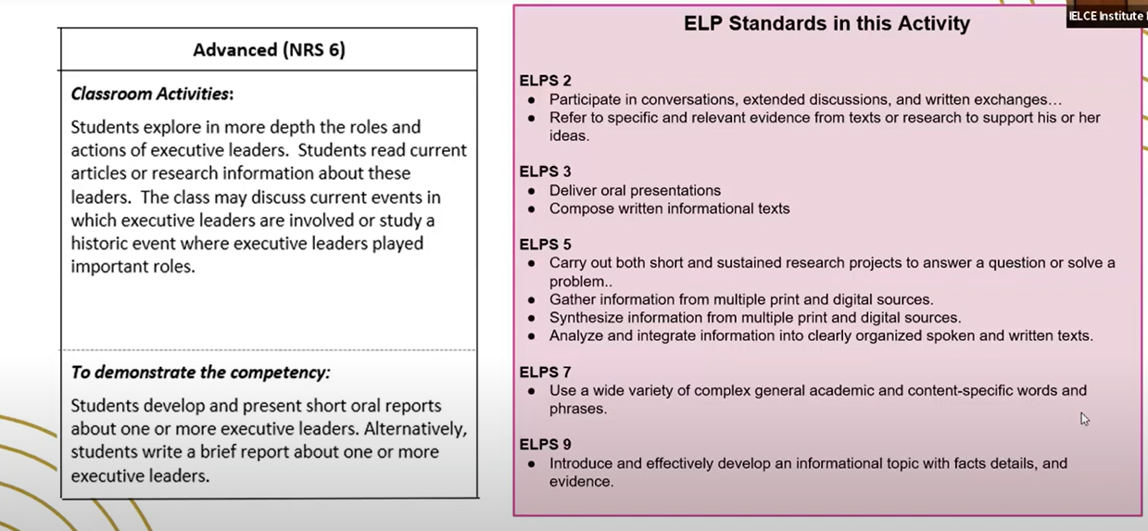

Slide 16
Standards Aligned Curriculum
TSTM
Burlington English
Aztec
GED Ready
Venture
Ensure new staff receive training on how to use content standards
Ensure that the curricula are standards aligned
Ensure that OER materials are standards aligned
Consider reviewing lesson plans to ensure alignment to the WI Adult Education and ESL Content Standards –
  Collaborative lesson planning and modification ( Standards in Action )

Slide 17
Discussion Questions
Given that AE/ESL Content Standards are meant to be a basis for curriculum design, instructional materials, and assessment strategies, how can programs and instructors use these standards effectively to ensure quality instruction?
How do your programs use the content standards when developing or choosing curriculum or designing lessons?
What are challenges of using the content standards in AE/ESL instruction?
What resources or training would be helpful to your program?

