Slide 1
AEFLA Fiscal & Grant Management

Slide 2
Timeline of AEFLA Sessions
April 15 - Overview of AEFLA, Eligibility, & WTCS Grant Manager Partnership​
April 22 – AEFLA Assessment Policy & Alternative Placement​
April 29 – WIDS & Course Content Standards​
May 6 – Program Design Foundations​ e.g., program orientations, Integrated Education & Training, etc.
May 13 – AEFLA Performance Accountability​
May 20 – AEFLA Fiscal & Grant Management​
Notes:
We are coordinating a series of informational sessions to provide foundational AEFLA knowledge as we approach the 2025-26 fiscal year. These sessions may be especially helpful for new staff at your organization. Please forward on the invitation as appropriate. We are counting on you to ensure the appropriate staff at your organization attend!

Slide 3
AEFLA Fiscal Information & Reminders

Slide 4
AEFLA Information
Adult Education Family Literacy Act (AEFLA) grants are reimbursement based.
The Standard Financial Report (SFR-1) is used to summarize budget proposals and expenditure claims for all projects funded through the Wisconsin Technical College System (WTCS). Each application must include the Budget Detailed and Standard Financial Report worksheet to be completed. Please make sure you are using the most updated worksheet for your grant.

Slide 5
AEFLA Information
Once the application is completed, the grant will go through the review process. If your grant is approved, you will be notified, and an award letter will be sent to your college. Once the grant period has started, the recipient can start submitting their SFR claim to WTCS for reimbursement.
SFR claims are completed and sent to WTCS (Victoria Chung) for grant reimbursement.
During a fiscal audit, the US Department of Education can request copies of completed SFR’s to be reviewed during their audit process.

Slide 6
AEFLA Reminders
Need to use the most recent version of the SFR on the WTCS Apply Portal (from approved application).
Reminder to submit reimbursement to Victoria once a month or every quarter at the least.
  Stay up to date with what has been reimbursed.
SFR Fiscal Overview handout for details regarding the grant reimbursement process will be in the chat.

Slide 7
Grants Management

Slide 8
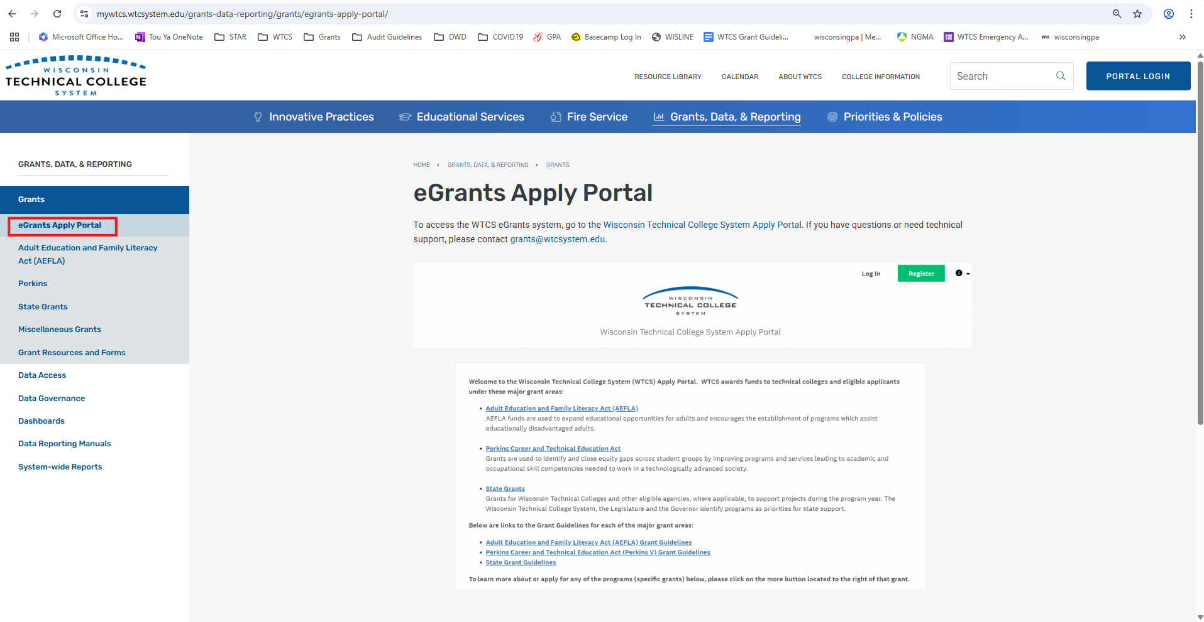
WTCS Apply Portal Guide

Slide 9
Grant Revision
Contact the WTCS Director overseeing the grant you would like to revise to ensure that the revision plans are allowable.
Formal revisions are needed if more than 20% of any budget line item is changing/moving.
Follow the revision process as shown in the WTCS Apply Portal Guide.
Only the owner of the approved grant can submit a revision.

Slide 10
Grant Reporting
Need to complete and submit two reports in the WTCS Apply Portal.
  Mid-Year report (covering July 1 – December 31 grant activity): must be received on or before February 15
  Final report (covering July 1 – June 30 grant activity): must be received on or before November 1
  Only owner of the approved grant can submit the reports.

Slide 11
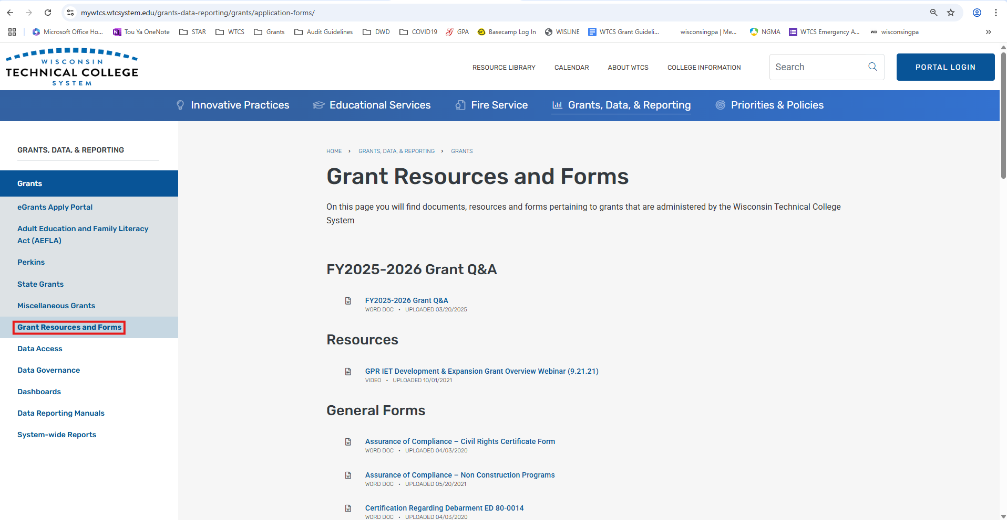
Grant Reporting

Slide 12
WTCS Grants: grants@wtcsystem.edu
Julie Tyznik: julie.tyznik@wtcsystem.edu
Tou Ya Khang: touya.khang@wtcsystem.edu
Victoria Chung: victoria.chung@wtcsystem.edu

