Slide 1
Overview of AEFLA, Eligibility, & WTCS Grant Manager Partnership

Slide 2
Timeline of AEFLA Sessions
April 15 - Overview of AEFLA, Eligibility, & WTCS Grant Manager Partnership​
April 22 – AEFLA Assessment Policy & Alternative Placement​
April 29 – WIDS & Course Content Standards​
May 6 – Program Design Foundations​ e.g., program orientations, Integrated Education & Training, etc.
May 13 – AEFLA Performance Accountability​
May 20 – AEFLA Fiscal & Grant Management​

Slide 3
Todays Agenda
Overview of AEFLA
WTCS Grant Manager Partnership
Eligibility – who can be served?

Slide 4

The Need for Wisconsin’s Adult Education Program
One in seven Wisconsin adults have low literacy and struggle to comprehend short sentences, fill out forms, and follow printed instructions – (PIAAC data)
354,000+ adults without a high school degree – (US Census)
142,000+ adults do not speak English very well or at all – (US Census)
One in four Wisconsin adults have low numeracy skills and struggle to understand and calculate ratios and percentages – (PIAAC data)
63,000+ immigrants admitted for legal permanent residence – (US Homeland Security 2014-23)
Wisconsin adults without a high school diploma are twice as likely to live in poverty than those with a high school diploma – (US Census)

Slide 5




Slide 6
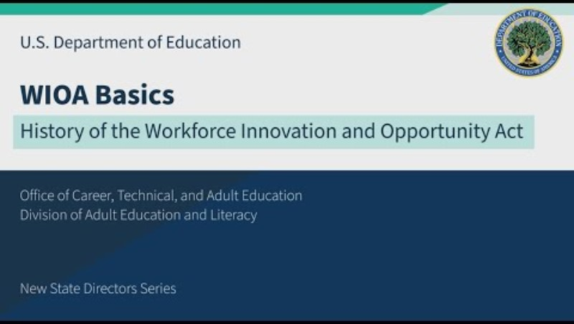
Start at 1 min 6 sec

Slide 7
Purpose of AEFLA
Largest federal investment in Adult Education ~ $715+ million FY 2024-25
Enhance literacy and numeracy skills
Assist learners in attaining a secondary school diploma and transition to postsecondary through career pathways
Assist immigrants and English language learners in improving their math, reading, writing, speaking, and comprehension skills in English and acquiring an understanding of the American system of Government, individual freedom, and the responsibilities of citizenship
Enhance economic opportunities for families

Slide 8

Wisconsin Adult Education Services
The Wisconsin Adult Education program helps students:
Strengthen reading, writing, speaking and numeracy skills for success in college and employment
Earn a high school degree
Earn college credits and credentials
Acquire English language learning competence
Build United States citizenship skills such as the rights and responsibilities of citizenship and civic participation
Build skills to better use technology
Enter a career pathway to obtain employment
Build connections between community-based organizations, employers and education partners
Create relationships with prisons and jails to enable re-entry pathways and reduce recidivism

Slide 9
Maximizing Impact: An Increase in Learners Served
45% of participants are English language learners
24% of participants are distance education learners
61% of participants have a barrier to employment e.g., single parent, disability, ex-offender, etc.
1,286 justice involved participants served

Slide 10
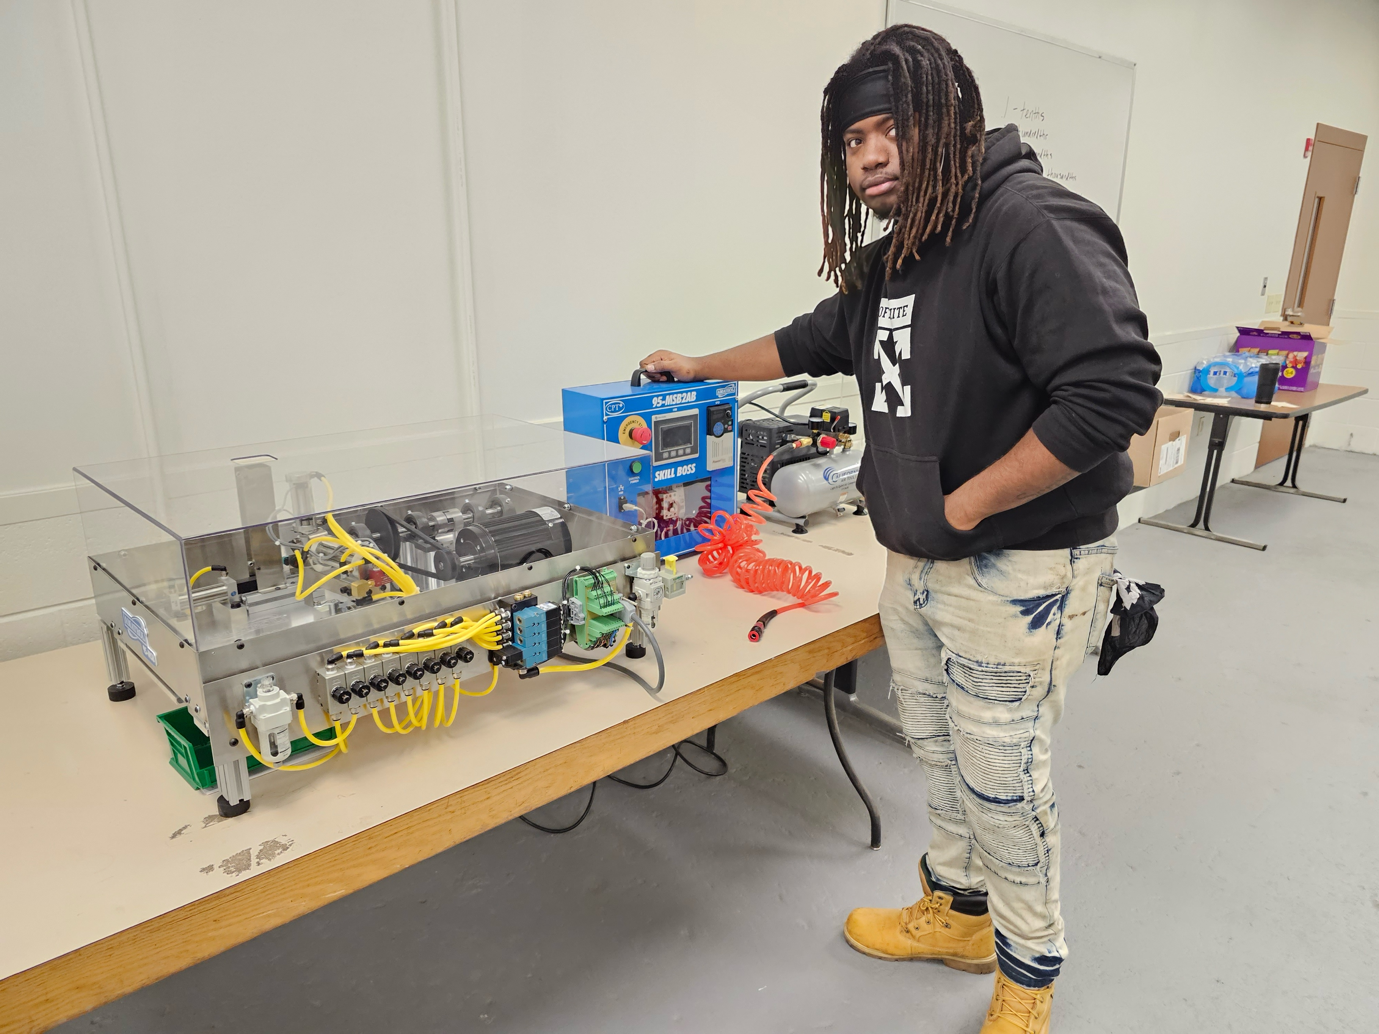

Enhancing Mobility & Career Pathways Engagement
Exceeded the nation in all federal indicators of performance related to education and employment
4,400+ participants significantly increased their reading, writing, mathematics, or English competence
2,700+ participants earned a high school equivalency diploma
2,500+ participants enrolled in postsecondary education within the year
45% reduction in recidivism among justice involved populations

Slide 11
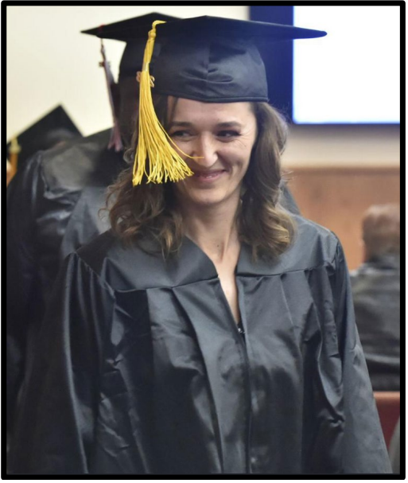
Wisconsin’s AEFLA Competition
Competition occurs every 4 years
Wisconsin AEFLA grant guidelines are our “Request for Proposal” or RFP
Running a fair and equitable competition
  WI Public Service posting
Panel reviews – individual review with group consensus
  NASDAE solicitation & state partners
Don't assume reviewers know your program
Rubric for scoring applications across 13 considerations, output areas, etc.

Slide 12



AEFLA Grant Managers
Adult Education Section 231
Available: $5,431,820
Corrections Section 225
Available: $700,000
IELCE Section 243
Available: $516,009
Ben Konruff, Ph.D.
State Director Adult Education & Literacy Services
Lenard Simpson
Director – Justice Involved Populations
Cristina Parente, M.Ed.
Director - English Language Learning
Your point of contact for the AEFLA grant award! Revisions, required reports, allowable activities, accessing the grant in the WTCS Apply Portal.

Slide 13
Who can receive AEFLA supported services?!?!

Slide 14
Eligible Individuals Under WIOA
Section 203(4) of WIOA defines eligible individuals as an individual:
Who has attained 16 years of age;
Who is not enrolled or required to be enrolled in secondary school under State law; and
Who is:
  Basic skills deficient which is defined by WIOA to mean, with respect to an individual
    who has English reading, writing, or computing skills at or below the 8th grade level on a generally accepted standardized test; or
    who is unable to compute or solve problems, or read, write, or speak English, at a level necessary to function on the job, in the individual’s family, or in society;
  An individual who does not have a secondary school diploma or its recognized equivalent and has not achieved an equivalent level of education; or
  An English language learner.

Slide 15
Eligible Individuals Under WIOA
Section 203(4) of WIOA defines eligible individuals as an individual:
Who has attained 16 years of age;
Who is not enrolled or required to be enrolled in secondary school under State law; and
Who is:
  Basic skills deficient which is defined by WIOA to mean, with respect to an individual
    who has English reading, writing, or computing skills at or below the 8th grade level on a generally accepted standardized test; or
    who is unable to compute or solve problems, or read, write, or speak English, at a level necessary to function on the job, in the individual’s family, or in society;
  An individual who does not have a secondary school diploma or its recognized equivalent and has not achieved an equivalent level of education; or
  An English language learner.

Slide 16
Wisconsin State Law & Eligible Individuals
s.118.15(1), Wis. Stats., defines compulsory school attendance and requires, with limited exceptions, all persons between the ages of 6 and 18 years to attend a secondary public, private, or tribal school for the full period and hours that the school is in session until the end of the school term in which the person becomes 18 years of age.

Slide 17
Wisconsin State Law & Eligible Individuals
s.118.15(1), Wis. Stats., defines compulsory school attendance and requires, with limited exceptions, all persons between the ages of 6 and 18 years to attend a secondary public, private, or tribal school for the full period and hours that the school is in session until the end of the school term in which the person becomes 18 years of age.
Exception #1
At Risk
Exception #2
Previously Justice Involved Juveniles

Slide 18
Eligibility Activity
Breakout Discussions. Identify a notetaker to share highlights from your discussion.
Review Section 3: Eligible Individuals details in the AEFLA grant guidelines
Open the scenarios document attached in the meeting invite
Review the scenario and reflect:
  Is the learner eligible for services? Why or why not?
  What questions do you have related to who is eligible for AEFLA services?

Slide 19
Ben Konruff, Ph.D.
State Director of Adult Education & Literacy Services
Wisconsin Technical College System
E-mail: ben.konruff@wtcsystem.edu

