Slide 1
AEFLA Performance Accountability

Slide 2
Timeline of AEFLA Sessions
April 15 - Overview of AEFLA, Eligibility, & WTCS Grant Manager Partnership​
April 22 – AEFLA Assessment Policy & Alternative Placement​
April 29 – WIDS & Course Content Standards​
May 6 – Program Design Foundations​ e.g., program orientations, Integrated Education & Training, etc.
May 13 – AEFLA Performance Accountability​
May 20 – AEFLA Fiscal & Grant Management​

Slide 3
Todays Agenda
Why data matters
What data is collected
How is data being used

Slide 4
Why does data matter in AEFLA?
~$7 million in AEFLA funds awarded annually in Wisconsin
Local Level
Wisconsin AEFLA Funded Providers
State Level
Wisconsin Technical College System Office
Federal Level
US Department of Education
Demonstrate success with grant awards
Program management to understand students and classes
Program improvement efforts
Ensuring learner access and success
Meet federal reporting requirements for funding
Inform negotiations with federal partners
Funding for local programs
Monitor local programs and identify technical assistance supports
To meet federal agency accountability requirements (GPRA)
To demonstrate program effectiveness to Congress
Monitor states and identify state technical assistance supports

Slide 5
Data Reporting Schedules
Local Level
Wisconsin AEFLA Funded Providers
State Level
Wisconsin Technical College System Office
Federal Level
US Department of Education
AEFLA required data is collected locally and reported annually to the WTCS Office at a minimum on:
October 14
January 14
April 14
July 14
AEFLA required data is collected for the state and reported annually to the US Department of Education the first week of October after the fiscal year closes
US Department of Education shares state and national report with Congress
Accountability and Reporting: Adult Education and Literacy State Grant Administration

Slide 6

Data Collection & Reporting
Each provider must collect AEFLA data
  Grant participation/exit, services received, and outcomes
  Demographics
  Barriers to employment
  Testing information
  Hours of service
  Proxy hours
Data Tornado!
Data
Data
Data
Data
Data

Slide 7
Strategies to Support Data Quality
Proactive – assessing data collection and reporting processes to identify data quality challenges before they happen
Reactive – using tools like internal and external reports to identify and audit data quality challenges after they happen

Slide 8
Proactive: Map out the student experience!
Individual Enters the Program
Student Intake
Data is collected throughout the student experience
Identify gaps or strengths in your data collection processes
Fully capture the work your program is doing via complete and accurate data
Initial Assessment
Participation
Outcomes & Post-test
Exit
No
Yes

Slide 9
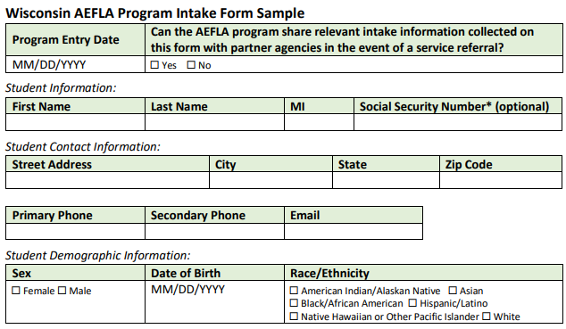
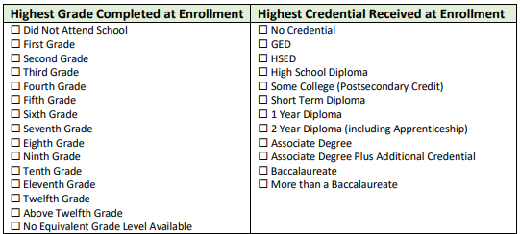
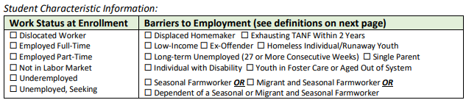
Sample AEFLA Program Intake Form

Slide 10

Proactive: WTCS tools to support data collection & reporting
Wisconsin AEFLA Data Flow Exercise
WTCS Client Reporting Manual for data definitions & allowable values

Slide 11
Breakout #1 – Data Collection & Quality
15-minute discussion with your peers
When do you collect AEFLA learner intake data? How is student participation, such as hours, and outcomes, such as posttest results, collected? Who does this work?
What student record-keeping system do you currently use to store AEFLA related data?
How are you ensuring quality of your AEFLA data? Are you reviewing data error reports regularly? Who is involved in this work?
What are your biggest challenges related to data collection and data quality? Any strategies to overcome these challenges?

Slide 12
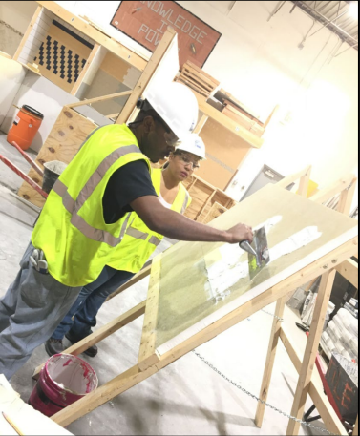


WIOA Primary Indicators of Performance:
A Focus on Workforce Immersion
Measurable Skill Gains
Employment Rate 2nd Quarter after Exit
Median Earnings 2nd Quarter after Exit
Employment Rate 4th Quarter after Exit
Credential Attainment Rate
Employer Retention Rate from 2nd to 4th Quarter
WI AEFLA Reporting and Performance Accountability Manual

Slide 13
Considerations for State Performance Targets
Historical Performance & Promote Continuous Improvement
Other State Comparisons
GPRA Targets
Statistical Adjustment Model

Slide 14
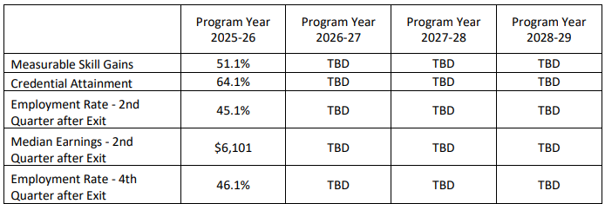
Wisconsin AEFLA Performance Targets
Wisconsin AEFLA grant applications document activities that support achievement of educational and workforce outcomes!

Slide 15
Breakout #2 – Supporting AEFLA Targets
15-minute discussion with your peers
Which of your program’s activities are supportive of employment outcomes such as Employment 2nd and 4th Quarter of Exit and Median Earnings 2nd Quarter after Exit?
Which of your program’s activities are supportive of high school equivalency attainment and postsecondary transitions?
In what areas do you think your program could strengthen in relation to our state performance outcomes? E.g., we need to build stronger employment connections, we need to accelerate time to HSED completion, we need to strengthen ELL to postsecondary, etc.

Slide 16
Timeline of AEFLA Sessions
April 15 - Overview of AEFLA, Eligibility, & WTCS Grant Manager Partnership​
April 22 – AEFLA Assessment Policy & Alternative Placement​
April 29 – WIDS & Course Content Standards​
May 6 – Program Design Foundations​ e.g., program orientations, Integrated Education & Training, etc.
May 13 – AEFLA Performance Accountability​
May 20 – AEFLA Fiscal & Grant Management​

Slide 17
Ben Konruff, Ph.D.
State Director Adult Education & Literacy Services
Wisconsin Technical College System
E-mail: ben.konruff@wtcsystem.edu

