Slide 1
AEFLA Program Design Foundations

Slide 2
Timeline of AEFLA Sessions
April 15 - Overview of AEFLA, Eligibility, & WTCS Grant Manager Partnership​
April 22 – AEFLA Assessment Policy & Alternative Placement​
April 29 – WIDS & Course Content Standards​
May 6 – Program Design Foundations​ e.g., program orientations, Integrated Education & Training, etc.
May 13 – AEFLA Performance Accountability​
May 20 – AEFLA Fiscal & Grant Management​

Slide 3
Todays Agenda
Federal & State Requirements
Discussion of Local Practices

Slide 4
Building Blocks of AEFLA Programs
Recruit
Orientation & Content Standards
Retention
Integrated Education & Training
Employ Qualified Staff
Staff Professional Development
Assessment Policy
Serve Eligible Individuals
Career Pathways
Section 4 of the AEFLA Grant Guidelines outlines federal and state-imposed requirements

Slide 5
Recruitment
“Develop processes to recruit target populations within the service region” pg. 10
Some points of reflection…..
Analyze population estimates to identify gaps in participation
Identify and document recruitment strategies
Develop recruitment materials that are easy to read, multilingual based on languages common to that area, and multimodal (e.g., radio, paper, social media, website, etc.)
Actively monitor recruitment strategies for success and maintenance

Slide 6
Breakout #1 - Recruitment
Discuss for 15 minutes in your breakout group!
What target populations are you actively recruiting to your program? How was this determined and what data sources were used to guide your targeted recruitment efforts?
What recruitment strategies (e.g., partner referrals, social media, print materials, community engagement, etc.) are you currently using to reach your target population?
What messages are you including in your recruitment strategies to attract prospective learners? E.g., tuition free services, flexible offerings with online instruction, high school equivalency services, etc.

Slide 7



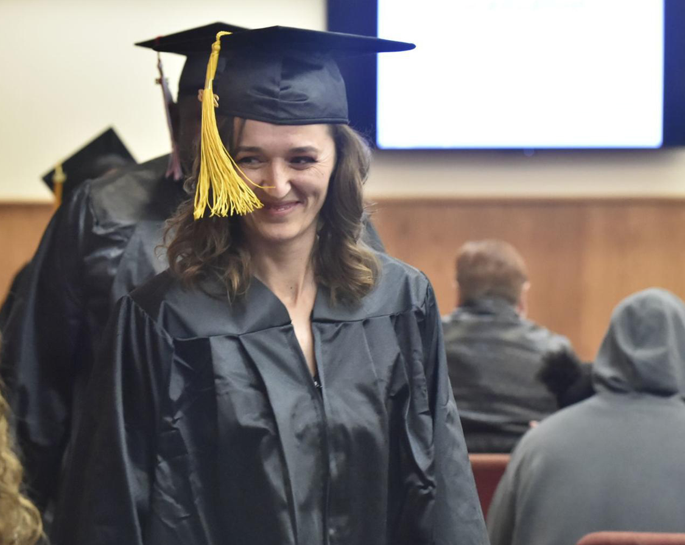
Orientation
“Delivering an orientation that includes at least three of the following components:
Assessment/testing
Personal Education Planning and goal setting
Digital literacy overview
Career exploration or understanding career pathways
Comprehensive intake and referrals” pg. 10

Slide 8
Breakout #2 - Orientation
Discuss for 15 minutes in your breakout group!
Describe the student experience within your orientation? What is covered e.g., assessment, personal education planning, digital literacy, career assessment, intake and referrals?
How long is your orientation?
How often is an orientation offered e.g., once per semester, on an as needed basis, etc.?
Who delivers the orientation?
Are there retention challenges between orientation participation and participation in future instruction? What retention strategies are used?

Slide 9

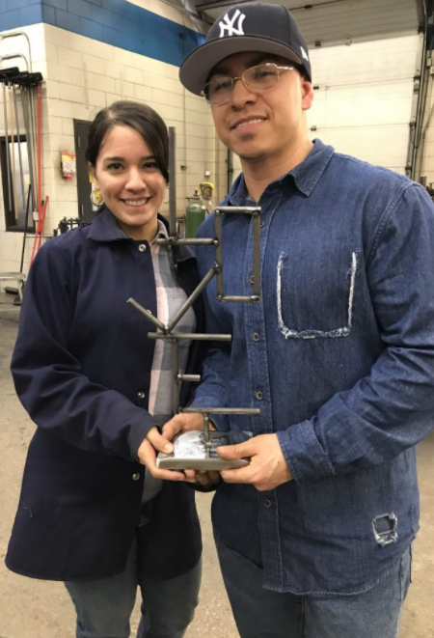

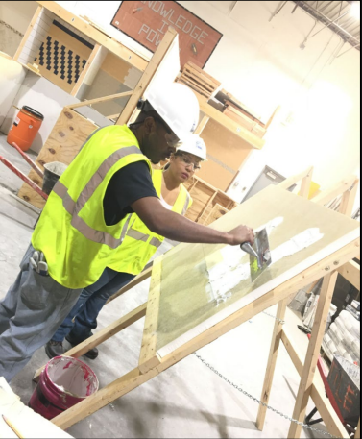
Integrated Education & Training
“Provide access to at least one integrated education and training program that includes adult education and literacy activities with workforce preparation activities and workforce training for a specific occupation or occupational cluster.” pg. 10

Slide 10
Breakout #3 – Integrated Education & Training
Discuss for 15 minutes in your breakout group!
What IET programs do you currently offer or extend access to through partnership with another organization? Who is the target audience and why, and what WTCS credential(s) or industry certification(s) does the IET connect to?
What barriers exist to offering/supporting IET participation? What solutions have you found in addressing the barriers?
Describe your existing relationship with internal and external IET partners such as employers and workforce partners? How have these relationships benefited IET programming? What is working well and what could be strengthened?

Slide 11
Timeline of AEFLA Sessions
April 15 - Overview of AEFLA, Eligibility, & WTCS Grant Manager Partnership​
April 22 – AEFLA Assessment Policy & Alternative Placement​
April 29 – WIDS & Course Content Standards​
May 6 – Program Design Foundations​ e.g., program orientations, Integrated Education & Training, etc.
May 13 – AEFLA Performance Accountability​
May 20 – AEFLA Fiscal & Grant Management​

Slide 12
Ben Konruff, Ph.D.
State Director of Adult Education & Literacy Services
Wisconsin Technical College System
E-mail: ben.konruff@wtcsystem.edu

