Slide 1
Wisconsin Integrated Education & Training (IET) Design Camp: IELCE Edition Learning Session #4 Developing a Single Set of Learning Objectives
Notes:
Hello and welcome to the fourth learning session of the Wisconsin Technical College Systems Integrated Education and Training Design Camp series: IELCE Edition

Slide 2

Resources taken from the Enhancing Access for Refugees and New Americans Project
https://lincs.ed.gov/state-resources/federal-initiatives/refugeesandnewamericans
Notes:
Resources for this training series were taken from the Enahcning Access for Refugees and New Americans- This project will be linked in our resources.

Slide 3
Learning Session Outcomes
Identify key features of a Single Set of Learning Objectives for ELs
Describe important steps to developing a single set of learning objectives
Notes:
Within this learning session, we will explore designing a single set of learning objectives. By the end of the session, you will be able to
-Identify key features of single set of learning objectives for ELs
-And describe important steps to developing a single set of learning objectives.
In this series, we will revisit the components of a SSLLO and ideas on how to develop them. I will include considerations and requirements for creating SSLOs for ELs. I will also specifically make references to creating an IET as a requirement for IELCE section 243 funding.

Slide 4
Understanding a Single Set of Learning Objectives
Notes:
Lets begin by exploring what a single set of learning objectives is and some of its key features

Slide 5
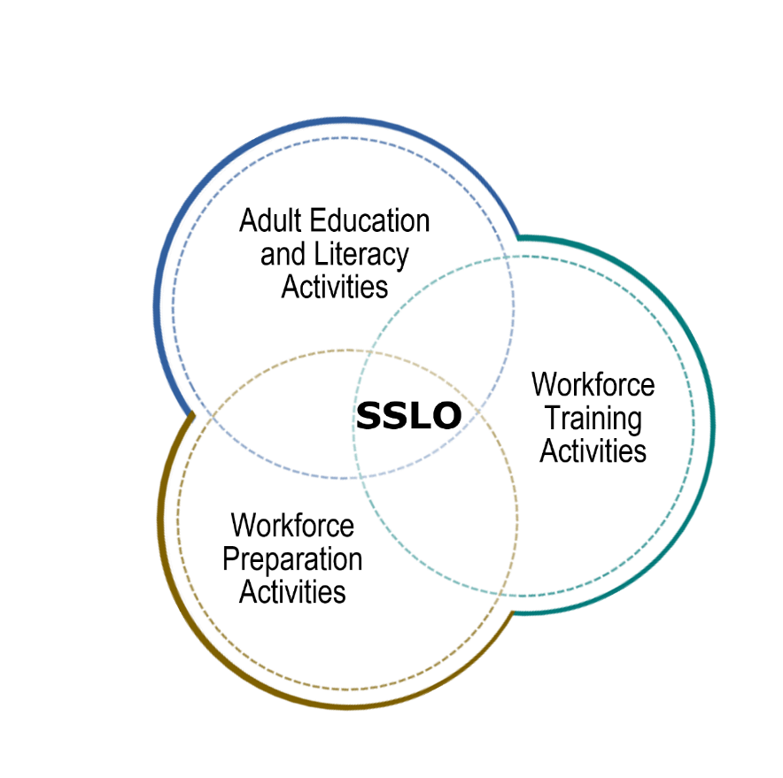
What is a Single Set of Learning Objectives?
An IET program has a single set of learning objectives that identifies the specific:
Adult education/ELA content
Workforce preparation activities
Workforce training competencies
Program activities are organized to function cooperatively
Notes:
The WIOA legislation makes it clear. IET programs under WIOA must have a single set of learning objectives. This set of learning objectives bring together the three required components of an IET so they are appropriately integrated and organized to function cooperatively. Together the creation of a single set of learning objectives forged through the integration of adult education and literacy activities, workforce training activities, and workforce preparation activities provide a clear message of what learners will experience and achieve through participation in an IET program. The SSLOs should be developed by both the AE/ESL faculty and the program faculty ( or workplace trainer). The SSLos will be used to review existing curricula, determine the need to modify or the need to develop new materials/

Slide 6
Example
1) Given the tools of the trade, learners will be able to describe the process for and apply knowledge of fractions and decimals to take and record precise measurements in decimals and fractions and use the measurements to answer fraction and decimal addition and subtraction questions with 80% accuracy
Workforce Training Skills and Competencies | Adult Education Content Standard(s) | Adult Education Literacy Skills and Competencies | EL Considerations: English Language Skills and Competencies | Workforce Preparation Skills and Competencies | EL Considerations: Civics Standards, Skills, and Competencies
• Read a 6” scale • Read a micrometer • Read a simple blueprint | Level 3: Learners can perform computations with fractions, ratios and rates, and narrative math problems. Learners can explore fundamental geometry concepts, apply measurement systems and apply statistical variability. Learners will practice communicating mathematically by using accepted tools and technology; by using appropriate vocabulary, notations, and labels; and by using estimation strategies to determine the reasonableness of a solution. | Convert measurements from inches to centimeters • Convert whole numbers to fractions • Add and subtract fractions | Participate in level appropriate oral and written exchanges of information, ideas, and analyses in various social and academic contexts, responding to peer, audience, or reader comments and questions (ELP 2, Level 3) • Conduct research and evaluate and communicate findings to answer questions or solve problems (ELP 5, Level 3) • Determine the meaning of words and phrases in oral presentations and informational text (ELP 8, Level 3) | • Apply mathematical operations, concepts, and reasoning • Demonstrate quality consciousness • Demonstrate self- management strategies • Work within a team | Identify, monitor, and anticipate problems, community needs, strengths, and resources for yourself and others (Texas, Civics Standards, Subarea 1A) • Participate in group processes and decision making (Texas, Civics Standards, Subarea 3E) • Educate others (Texas, Civics Standards, Subarea 4B)
Notes:
Here is an example of one integrated learning objective for a manufacturing IET. This represents just one integrated learning objective that would be included in a series to make up a complete single set of learning objectives. From the example, you can see the workforce training, adult education, and workforce preparation content clearly documented.
This content comes together to form the presented integrated learning objective. n, the integrated learning objective demonstrates how the three required components will occur simultaneously within the overall scope of the IET.
The process for developing the single set of learning objectives (SSLO) for an IELCE IET program is the same as that of developing the SSLO for an IET program that does not draw on Section 243 funds. The difference in creating SSLOs for IET programs that serve ELs is that in addition to the occupation skills, academic standards, and workforce preparation competencies, the program should also include relevant English language instruction and support. Although WIOA does not require IET programs to include civics, when developing IET programs that serve ELs and/or immigrants, it may be helpful to consider whether there is civics content that should be integrated into the IET program. Although WIOA requires that IET programs be built around an SSLO, the IET Design Toolkit notes that “WIOA does not prescribe the process for creating the SSLO”; the same is true for creating the SSLO for an IELCE IET program.
The sections in blue represent what is already on the WI IET planning tool.
The sections in purple represent proposed changes that will be made to the WI planning tool to include ELA competencies and content standards for AE and ELA. This represents a more intentional approach to ensuring tha the content standards are built into the SSLOs and therefor ethe subsequent curriculum and lesson activities.
An IELCE IET program and IETs that target ELs will need to consider the following when curricula are developed:
• Adult education and literacy activities are provided within the context of English language acquisition.
• The cultural context of the U.S. workplace that is relevant to the workforce training is provided as a part of the workforce preparation activities.
The integration of civics content Wiscosin does not currently have specific civics content standards, however, for IECLE activities and programs under 243 ( which are not IETs), it is still required to integrate civics instruction

Slide 7
Developing a Single Set of Learning Objectives
Notes:
Now that we have covered what a single set of learning objectives is, let explore important steps to consider when crafting a single set of learning objectives.

Slide 8
Step by Step Process
STEP
STEP
STEP
STEP
STEP
STEP
01
02
03
04
05
06
Revisit the learner, program, and partner goals
Identify workforce training skills and competencies
Identify state adult education standards and academic literacy skills and ELL standards and skills
Identify workforce preparation skills and competencies
Identify civics content
Build out contextualized units, lessons and activities
Notes:
There are multiple approaches to developing a single set of learning objectives. Within this session, we will cover one approach that includes 6 important sets.
The first step is revisiting your proposed IET’s learner, program, and partner goals. Are these goals still valid or might they need to be modified? These goals will provide a foundation for the Single set of learning objectives, because you will align the learning objectives with your program-level goals.
Revisit the program-level goals (learner, program, and partner) identified in Phase 2.
Step 2: Identify the workforce training skills and competencies. • As you work with your training partner to identify the specific knowledge, skills, and competencies needed to accomplish the program goals, also identify linguistic aspects of the content where students may need additional vocabulary or other language skill development so that vocabulary and linguistic structures do not impede their success in mastering the content. For example, workplace instructions that include mathematical concepts or problems often rely on English language comprehension for the task to be successfully completed. • You may also be able to identify civics content, such as regulatory information (e.g., housing rules, caregiver legislation) that is applicable to a broader understanding of civic integration and U.S. society, that can be intentionally addressed in the curricula.
Step 3: Identify the English language and/or state adult education standards and academic literacy skills.
• Use your state’s English language standards along with or in place of your academic standards. Focus on academic literacy skills that are transferable to support an EL’s success in the course and the possibility for transitioning to further training or educational opportunities.
Step 4: Identify workforce preparation skills and competencies. • Include cultural competence as a focus in the workforce preparation component of the program to help learners understand industry norms and U.S. workplace culture.
Step 5: Identify civics content. • Although civics content is not required for IET, IET programs can intentionally integrate civics content building on civics content that was taught in IELCE activities or that may be generally helpful for ELs and/ or immigrants in the IET program. Civics topics can include workforce preparation skills, broader rules and regulations associated with industry or consumer rights, cultural competency, the U.S. workplace, and associated tasks aligned to employment or community integration, such as reading and understanding a paycheck, understanding healthcare benefits, and opening a bank account. Content could include: - Navigating the workplace and work-related organizational structures - Institutions associated with the workplace (e.g., licensing organizations, unions, and financial literacy) - Licensing requirements or regulations for the identified industry or job
The last step requires reflection on your identified Single Set of Learning Objectives. In this step, you will build out contextualized units, lessons, and activities which align with the described integrated learning objectives and support mastery to achieve IET program goals.

Slide 9
Summary
A Single Set of Learning Objectives are a key requirement of an IET program
Integrate the three required components of an IET
Document what learners will be able to do upon completion of the IET
Closely align with IET program goals
Identify civics content is applicable to a broader understanding of civic integration and U.S. society, that can be intentionally addressed in the curricula.
Adult education and literacy activities are provided within the context of English language acquisition.
IET units, lessons, and activities are crafted in response to the Single Set of Learning Objectives
Notes:
In summary, Wisconsin providers of IET programs must develop a Single Set of Learning Objectives for their IET. These learning objectives integrate the three required components of an IET, document what learner will be able to do upon completion of the IET, and closely align with the IET’s program goals. Once identified, the Single Set of Learning Objectives will provide valuable insights to staff as they develop IET units, lessons, and activities to support student learning.

